Slide 1
Guide to Programming with Python
Chapter Twelve
Sound, Animation, and Program Development: The Astrocrash Game

Slide 2
Objectives
Read the keyboard
Play sound files
Play music files
Create animations
Develop a program by writing progressively more complete versions of it

Slide 3
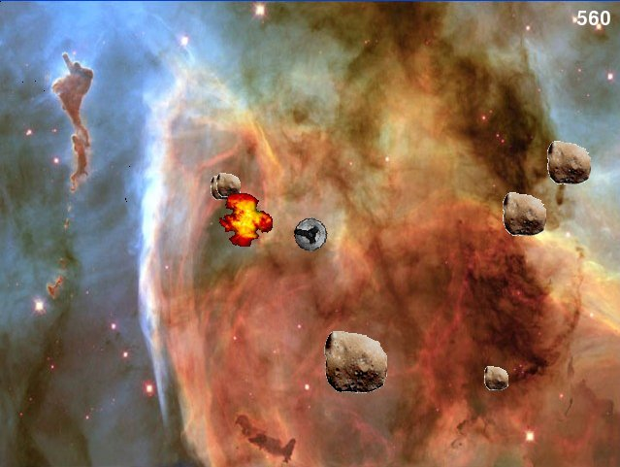
The Astrocrash Game
Figure 12.1: Sample run of the Astrocrash game
The player controls a spaceship and blasts asteroids.

Slide 4
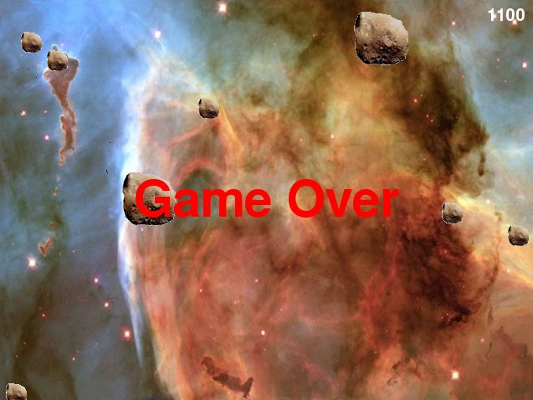
The Astrocrash Game (continued)
Figure 12.2: Sample run of the Astrocrash game
If an asteroid hits the player’s ship, the game is over.

Slide 5
Reading the Keyboard
The games module has facilities for reading individual keystrokes for typical game input.
Use this module to incorporate keyboard navigation within your game.

Slide 6
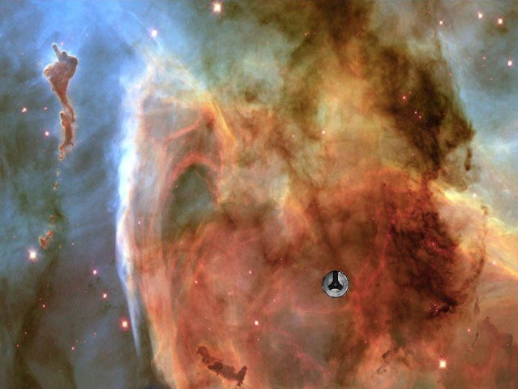
The Read Key Program
Figure 12.3: Sample run of the Read Key program
The ship moves around the screen based on keystrokes.

Slide 7
Example Code Testing for Keystrokes
class Ship(games.Sprite):
""" A moving ship. """
def update(self):
""" Move ship based on keys pressed. """
if games.keyboard.is_pressed(games.K_w):
self.y -= 1
if games.keyboard.is_pressed(games.K_s):
self.y += 1
if games.keyboard.is_pressed(games.K_a):
self.x -= 1
if games.keyboard.is_pressed(games.K_d):
self.x += 1

Slide 8
Testing for Keystrokes (continued)
keyboard object from the games module
Test for specific keystrokes
is_pressed() method, returns True if the key being tested for is pressed, and False otherwise
Read Key program tests for W, S, A, and D keys
W key is pressed, decrease object’s y property by 1
S key is pressed, increase object’s y property by 1
A key is pressed, decrease object’s x property by 1
D key is pressed, increase object’s x property by 1

Slide 9
Testing for Keystrokes (continued)
games module has a set of key constants
All begin with games.K_
Alphabetic keys end in lowercase key letter
K_a for A
Numeric keys end in number
K_1 for 1
Complete list of keyboard constants in Appendix A

Slide 10
Rotating a Sprite
Can set sprite angle
Can rotate sprites

Slide 11

The Rotate Sprite Program
Figure 12.4: Sample run of the Rotate Sprite program
The ship can rotate or jump to a predetermined angle.

Slide 12
The Rotate Sprite Program (continued)
class Ship(games.Sprite):
""" A rotating ship. """
def update(self):
""" Rotate based on keys pressed. """
if games.keyboard.is_pressed(games.K_RIGHT):
self.angle += 1
if games.keyboard.is_pressed(games.K_LEFT):
self.angle -= 1

Slide 13
The Rotate Sprite Program (continued)
if games.keyboard.is_pressed(games.K_1):
self.angle = 0
if games.keyboard.is_pressed(games.K_2):
self.angle = 90
if games.keyboard.is_pressed(games.K_3):
self.angle = 180
if games.keyboard.is_pressed(games.K_4):
self.angle = 270

Slide 14
Using a Sprite’s angle Property
Sprite angle property represents facing in degrees
In Rotate Sprite program
Right arrow key is pressed, increase angle by 1
Left arrow key is pressed, decrease angle by 1
1 key is pressed, angle set to 0
2 key is pressed, angle set to 90
3 key is pressed, angle set to 180
4 key is pressed, angle set to 270

Slide 15
Creating an Animation
Animation: A sequence of images (frames) displayed in succession
Frame: A single image in a sequence of images for an animation
Animation class for animations

Slide 16
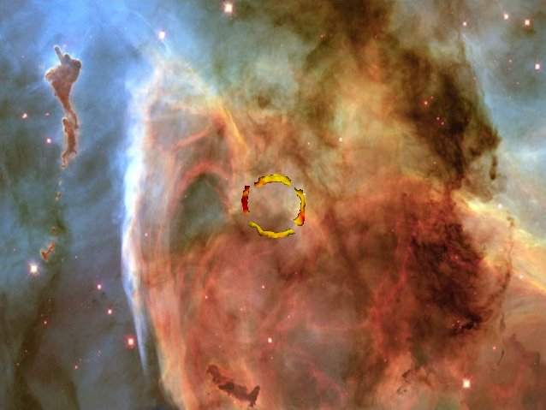
The Explosion Program
Figure 12.5: Sample run of the Explosion program
An explosion animates at the center of the graphics window.

Slide 17
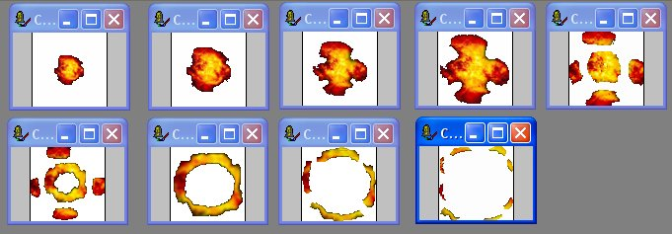
Examining the Explosion Images
Figure 12.6: Explosion images
Shown in succession, the nine frames look like an explosion.

Slide 18
Creating a List of Image Files
explosion_files = ["explosion1.bmp",
"explosion2.bmp",
"explosion3.bmp",
"explosion4.bmp",
"explosion5.bmp",
"explosion6.bmp",
"explosion7.bmp",
"explosion8.bmp",
"explosion9.bmp"]

Slide 19
Creating an Animation Object
explosion = games.Animation(images=explosion_files,
x=games.screen.width/2,
y=games.screen.height/2,
n_repeats = 0,
repeat_interval = 5)
games.screen.add(explosion)

Slide 20
Creating an Animation Object (continued)
Animation class derived from Sprite
Animation constructor takes list of image file names as strings or a list of image objects
n_repeats number of times animation displayed
0 means loop forever
repeat_interval delay between images
Increase number for slower animation
Decrease number for faster animation

Slide 21
Working with Sound and Music
Sound and Music
Load
Play
Loop
Stop

Slide 22
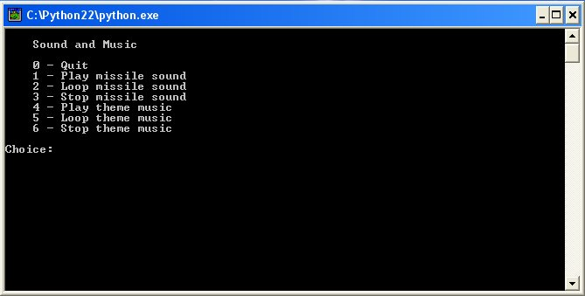
The Sound and Music Program
Figure 12.7: Sample run of the Sound and Music program
The program lets the user play a sound and some music.

Slide 23
Working with Sounds
Can create sound object by loading a WAV file
The WAV format is great for sound effects

Slide 24
Loading a Sound
missile_sound = games.load_sound("missile.wav")
load_sound() function
Takes a string for name of the sound file, returns sound object
Can only load WAV files

Slide 25
Playing a Sound
missile_sound.play()
play() method plays sound once
Playing a sound
Requires at least one open sound channel
Takes up one of the eight available sound channels
Has no effect if all eight sound channels are in use

Slide 26
Looping a Sound
missile_sound.play() #Plays 1 time
missile_sound.play(3) #Plays 4 times
missile_sound.play(-1) #Plays indefinitely
play() can take value for looping
Value is number of additional times sound should be played after initial playing
Pass -1 to loop forever

Slide 27
Stopping a Sound
missile_sound.stop()
stop() method stops sound on all channels it’s playing
Calling stop() while sound not playing will not produce error

Slide 28
Working with Music
Music is handled somewhat differently than sound
Only one music channel
Don’t create a new object for each music file; instead, access a single object to load, play, and stop music
Music channel accepts many different types of sound files, including WAV, OGG, MP3, and MIDI

Slide 29
Loading Music
games.music.load("theme.mid")
music object has methods to load, play, and stop the single music track
Loading music track replaces current track

Slide 30
Playing Music
games.music.play()
play() plays currently loaded music
If pass no value to play(), music plays once

Slide 31
Looping Music
games.music.play(-1)
play() can take value for looping
Value is number of additional times sound should be played after initial playing
Pass -1 to loop forever

Slide 32
Stopping Music
games.music.stop()
stop() method stops music from playing
Calling stop() while music not playing will not produce error

Slide 33
Planning the Astrocrash Game
Write progressively more complete versions
List details
Features
Classes
Assets

Slide 34
Game Features
Ship rotate and thrust based on keystrokes
Ship fire missiles based on a keystroke
Asteroids float at different velocities on the screen; smaller asteroids generally have higher velocities than larger ones
Ship, missiles, and asteroids “wrap around” screen
Missile collides with ship or asteroid, both destroyed and produce explosion
Ship collides with asteroid, both destroyed and produce explosion
Large asteroid destroyed, two medium asteroids produced

Slide 35
Game Features (continued)
Medium asteroid destroyed, two small asteroids produced
Small asteroid destroyed, no new asteroids produced
Ship destroyed, game over
Player earns points for asteroids destroyed; smaller asteroids worth more than larger ones
Player’s score displayed in upper-right corner of screen
All asteroids destroyed, larger wave of asteroids produced

Slide 36
Game Classes
Ship
Missile
Asteroid
Explosion

Slide 37
Game Assets
Image file for ship
Image file for missiles
Three image files, one for each size of asteroid
Series of image files for explosion
Sound file for thrusting of ship
Sound file for firing of missile
Sound file for explosion
Music file for the theme

Slide 38
Creating Astrocrash
The Astrocrash01 Program
Create eight asteroids at random locations
Velocity of asteroid is random; smaller asteroids have potential to move faster than larger ones
Could have chosen to start differently (with player ship, for example)
Key is to build progressively more complete versions

Slide 39
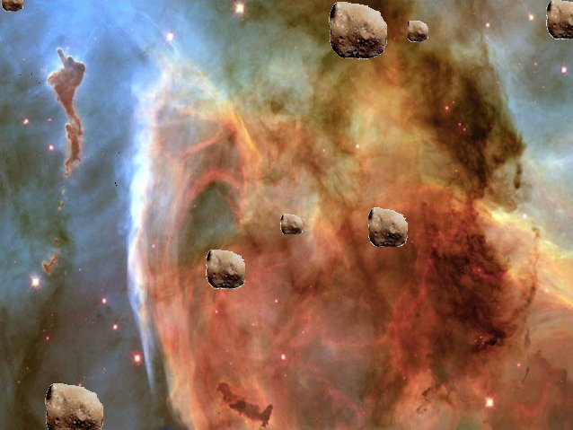
The Astrocrash01 Program
Figure 12.8: Sample run of the Astrocrash01 Program
Eight asteroids float along in space.

Slide 40
Rotating the Ship
The Astrocrash02 Program
Create ship at center of the screen
Player can rotate ship
Player presses Right Arrow key, ship rotates clockwise
Player presses Left Arrow key, ship rotates counterclockwise

Slide 41
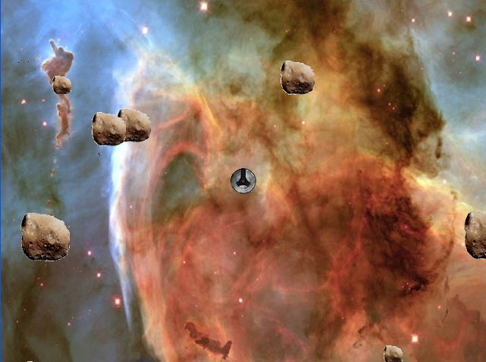
The Astrocrash02 Program
Figure 12.9: Sample run of the Astrocrash02 Program
Player can rotate the ship.

Slide 42
Moving the Ship
The Astrocrash03 Program
Player presses Up Arrow to engage ship’s engine; applies thrust to ship in facing-direction
Engaging engine produces sound effect

Slide 43
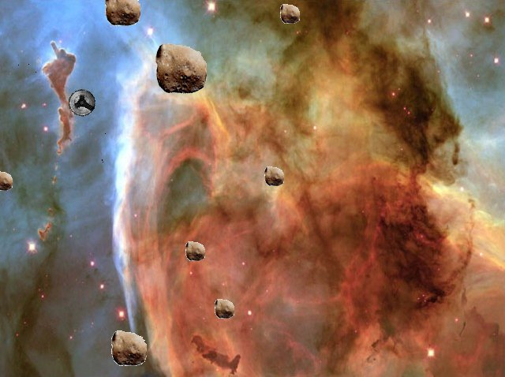
The Astrocrash03 Program
Figure 12.10: Sample run of the Astrocrash03 Program
Player can now engage ship’s engines and thrust around screen.

Slide 44
Firing Missiles
The Astrocrash04 Program
Player presses the spacebar, fires missile
Missile created in front of ship’s cannon and flies off in direction ship facing
Omit collision detection for now
Problem: if player holds down the spacebar, stream of missiles pours out at rate of 50/second
Fix problem in future version

Slide 45
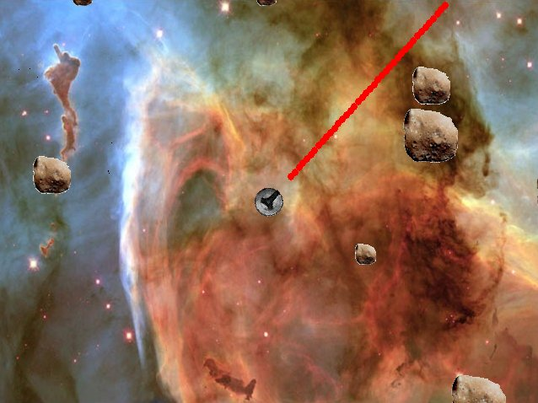
The Astrocrash04 Program
Figure 12.11: Sample run of the Astrocrash04 Program
Ship’s firing rate is too rapid.

Slide 46
Controlling the Missile Fire Rate
The Astrocrash05 Program
Limit fire rate by creating countdown that forces delay between missile firings
Once the countdown ends, player can fire again

Slide 47
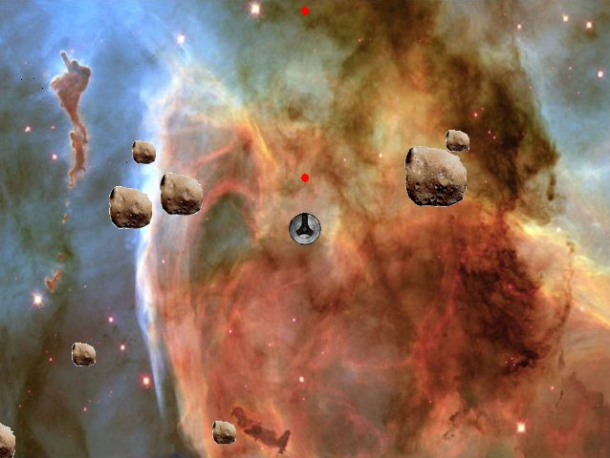
The Astrocrash05 Program
Figure 12.12: Sample run of the Astrocrash05 Program
Ship fires missiles at a more reasonable rate.

Slide 48
Handling Collisions
The Astrocrash06 Program
Missile collides with other object, destroys self and other
Ship collides with asteroid, destroys self and asteroid
Asteroids passive; don’t want overlapping asteroids to destroy each other
Asteroids destroyed can produce new asteroids
Problem: because asteroids initially generated at random locations, possible for one to be created on top of ship, destroying ship just as program begins
Fix problem in future version

Slide 49
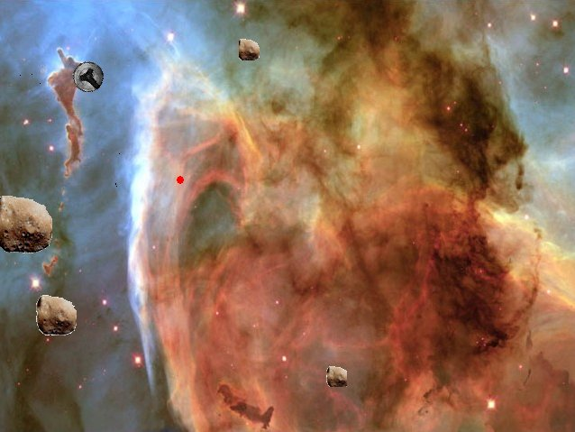
The Astrocrash06 Program
Figure 12.13: Sample run of the Astrocrash06 Program
Ship’s missiles destroy asteroids and asteroids destroy ship.

Slide 50
Adding Explosions
The Astrocrash07 Program
Add explosions as result of collisions
Remove redundant code

Slide 51
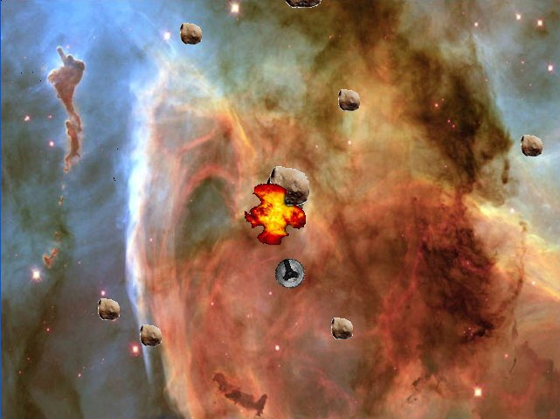
The Astrocrash07 Program
Figure 12.14: Sample run of the Astrocrash07 Program
Destruction now accompanied by fiery explosions.

Slide 52
Adding Levels, Scorekeeping, and Theme Music
The Astrocrash08 Program
Add levels; when player destroys all asteroids, a new, more plentiful batch produced
Add scorekeeping functionality
Add theme music
Reorganize some code

Slide 53
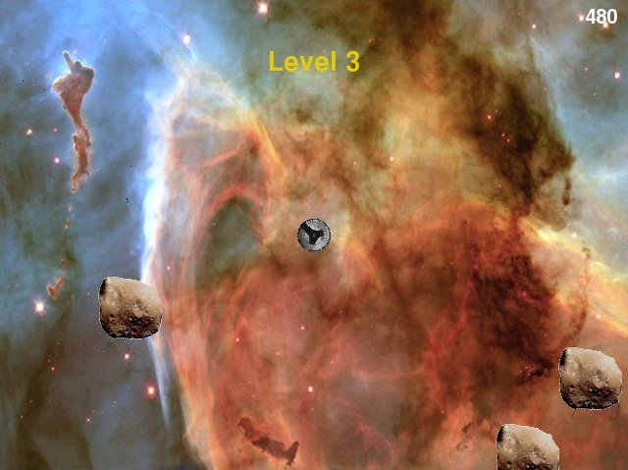
The Astrocrash08 Program
Figure 12.15: Sample run of the Astrocrash08 Program
Final version of the game

Slide 54
Summary
keyboard object provides access to keyboard
keyboard.is_pressed() tests if specific key is being pressed
games module defines set of key constants
sprite objects have angle property that represents an object’s orientation in degrees
Animation is a subclass of Sprite for graphics objects that are series of images shown in succession

Slide 55
Summary (continued)
Animation object has properties for a set of images to cycle through, current image, speed, orientation, and overlapping objects, among others
games.load_sound() loads a sound stored in a WAV file and returns a sound object
sound object has play() method that plays sound
sound object has a stop() method that stops sound
music object provides access to single music track

Slide 56
Summary (continued)
music.load() loads music track
music.play() plays current music track
music.stop() stops current music track
After creating design, writing progressively more complete versions of program is one strategy for large projects
Astrocrash, based on classic game, is written in eight successively more complete versions

